Slide 1
Foreign National Process
By: Deborah Melendez & Christina Brown
June 2023

Slide 2
AGENDA
Introduction​ / Importance
Area Office Pre-Name Trace Paperwork
NonFed Suitability Ticket
Timeline
Questions
Name Trace Ticket
Area Office Post Name Trace Paperwork
External Links

Slide 3
Introduction and Importance

Slide 4
Introduction
Deborah Melendez - MWA HRL
  Process the FN name trace ticket, processes the Non fed suitability tickets
Christina Brown – MWA Area Office
  Quality checks the Biographical sketch, project information, ARS-215 and Area memo
Importance
Collaborating with foreign nationals/visitors is a critical component to USDA’s REE agencies’ research success. These collaborations benefit USDA and the Nation by strengthening scientific research.
The foreign nationals/visitors program coordinates with universities, federal agencies, foreign universities, and foreign agricultural institutes to bring foreign nationals to our facilities, as nonfederal employees, to collaborate on research that is vital to the department mission.
The process of vetting and onboarding foreign national/visitors is streamlined via the AFM Customer Service Portal process, and the AFM Customer Service Portal serves as USDA’s official repository for foreign nationals/visitors records and history.
Submitting the correct paperwork fully completed and timely ensures no delay to Foreign National being able to come when they are wanting to.

Slide 5
Timeline

Slide 6





To Area Office
TO HRL
To Area Office
Waiting Period
Arrival
Extend as required
Submit Bio sketch and project information to area office for approval
Start name trace ticket.
Ensure passport is attached, and FN section on ticket is fully filled out
Send ARS-215 and area memo for signature AFTER name trace is cleared
Work with FN to ensure all required documents are attached to ticket BEFORE FN arrival
Update ticket with arrival date and ensure suitability ticket is started
Re-open ticket and start new paperwork yearly as needed

Slide 7
Area Office
Pre-Name Trace Paperwork
To Area Office
Christina Brown

Slide 8
Biographical Sketch/Project Information
https://axon.ars.usda.gov/Inside%20ARS/AO-Hub/Pages/ARS-Foreign-Visitor-Program.aspx
ARS Foreign National Visitors Biographical Sketch Conversion - https://axon.ars.usda.gov/Inside%20ARS/AO-Hub/Documents/ARS%20Foreign%20National%20Visitors%20Biographical%20Sketch%20Conversion.pdf
Project Information for ARS Foreign Visitors - https://axon.ars.usda.gov/Inside%20ARS/AO-Hub/Documents/Project%20Information%20for%20ARS%20Foreign%20Visitors%20-%20Fillable.pdf

Slide 9
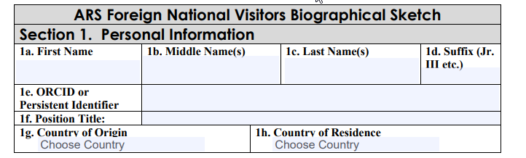
Biographical Sketch – Section 1
1a. – 1d. This information should match what is identical on the FN/FV Passport
1e. – This is optional – the FN/FV may not have an ORCID. Can search ORCID website: www.orcid.org The FN/FV can apply later if they would like to have an ORCID
1f. Enter current position title (e.g. post-doc, name of professional title)
1g. Country of Origin – this should be where the FN/FV originates and the same as passport
1g. Country of Country Residence – this should be where the FN/FV permanently resides.

Slide 10
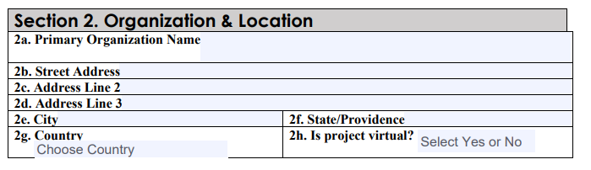
Biographical Sketch – Section 2
2a. Primary Organization Name – Name of Unit FN/FV is applying to work.
2b – 2g. Address of Primary Organization (Unit address, not the university address if co-located).
2h. Is project virtual? – Simple Yes or No drop down selection.

Slide 11
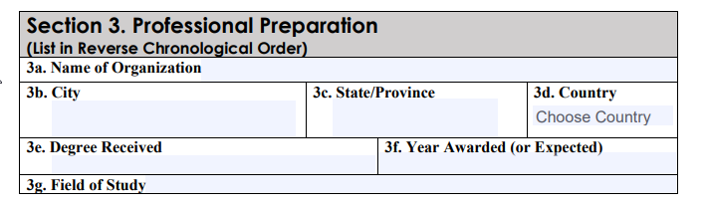
Biographical Sketch – Section 3
Reverse Chronological Order (Newest First)
3a. Name of Organization – This mainly will be the name of the Universities of degrees that are or will be obtained
3b – 3d. Address Information of Organization listed in 3a.
3e. Degree Received or Degree that will be received
3f. Year Award – This is the year that the degree is received or will be received
3g. Field of Study – Name of Major and/or Minor of the study
Space for multiple information/organizations – do not have to use all blocks

Slide 12
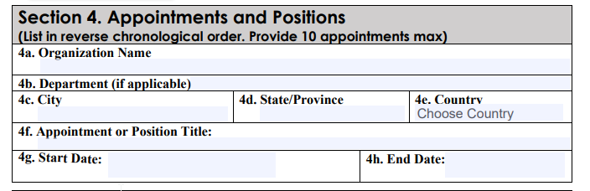
Biographical Sketch – Section 4
Reverse Chronological Order (Newest First) – 10 Appointments MAX
4a. Name of Organization – Be the name of where the FN/FV has held any type of appointment/position
4b. Department – Name of the department (if applicable), where a FN/FV held appointment (e.g. University of Wisconsin – Madison would be the name of the organization, name of department – Department of Horticulture)
4c.-4e. General Address information for Name of Organization
4g. – Start date of appointment/position
4h. – End date of appointment/position – if current, use projected end date
Space for multiple information/organizations – do not have to use all blocks

Slide 13
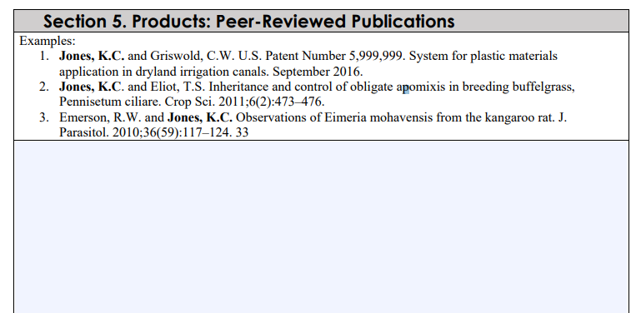
Biographical Sketch – Section 5
List publications in reverse chronological order (newest first) with all authors in proper order. Give full references including journal, volume and complete pagination. List only those already published or accepted by the publishing agent. For multiauthor documents, bold your name.
Examples:
Jones, K.C. and Griswold, C.W. U.S. Patent Number 5,999,999. System for plastic materials application in dryland irrigation canals. September 2016.
Jones, K.C. Cotton Crops of Texas, pp. 78–94. In Brown, D.F. and Black, J.R. (eds.) Cotton of the South. New York: Simplex. 328 pp. 2015. (Book Chapter)
Emerson, R.W. and Jones, K.C. Observations of Eimeria mohavensis from the kangaroo rat. J. Parasitol. 2010;36(59):117–124. 33

Slide 14
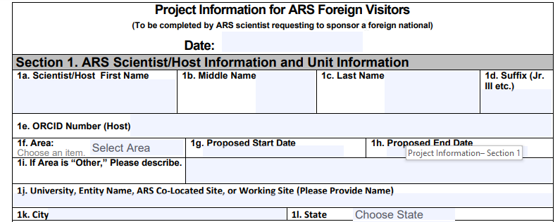
Project Information– Section 1
1a.- 1d. Will be the full name/information of the Host SY
1e. This will be the Host SY’s ORCID Number. It can be found www.orcid.org – SY should know this information
1f. This will always be MWA
1g. – 1h. Proposed Start & End Date – this will be for the length maximum of ONE year only, if here longer, will need to process extension. Also Agreement and Project Information must not expire during this time. End date will be- Potential Name Trace Extension, Agreement or Project Expiration Date
1j. – Name of ARS Co-Located Site (e.g. University of Wisconsin – Madison; Iowa State University; Purdue University, etc.)
1k. – 1l. City and State of Co-Located Site

Slide 15
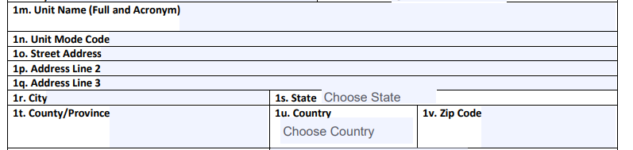
Project Information– Section 1 Continued
1m. Enter Full Name of Unit and Include Acronym (e.g. Vegetable Crop Research Unit (VCRU)
1n. Enter Unit Mode Code (e.g. using VCRU – 5090-10-00)
1o.-1v. Enter the address of the Unit, not the address of the ARS Co-Located Site (e.g. VCRU – 1575 Linden Dr., Madison, WI, Dane County, United States, 53706-1514

Slide 16
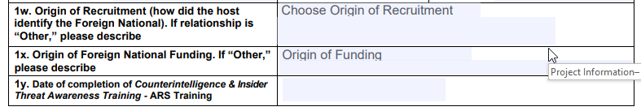
Project Information– Section 1 Continued
1w. How did the recruitment of the FN/FV happen. Drop down choice; if OTHER please describe in the box how recruitment was established.
1x. FN/FV Funding – How will the foreign national be funded while working with ARS. Again, if OTHER please detail.
1y. Date of most recent completed Counterintelligence & Insider Threat Awareness Training- ARS Training – This will be in AgLearn.

Slide 17
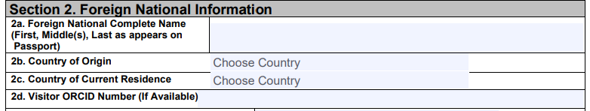
Project Information– Section 2
2a. Name of FN/FV should be the same name that is located on their passport
2b. – 2c. Country of Origin and Country of Current Residence should be the same as what is the biographical sketch
2d. ORCID Number – This should match what is on the biographical sketch, again, not mandatory and can be found at www.orcid.org. If FN/FV does not have a current ORCID, the FN/FV can apply for one.

Slide 18
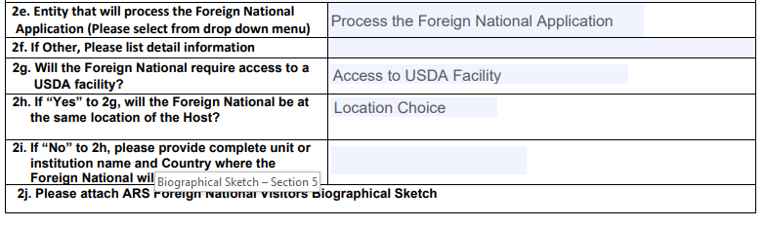
Project Information– Section 2 Continued
2e. ORISE, CDRF, University, Other
2f. If other list who – this typically should not be used
2g. Will be YES or NO
2h. If 2g. is YES, answer will be YES or NO
2i. If NO to 2h. Please complete unit or institution information and where the FN/FV may be working (this may be virtual)
2j. Cannot attach to this document but include together in same email.

Slide 19
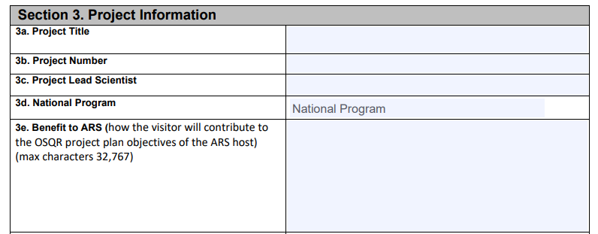
Project Information– Section 3
3a. Project Title – Will be the same information pulled from ARIS
3b. Project Number – The Project Number will match the same information from ARIS and will match the Project Title
3c. Name of Lead Scientist (may not be the same of the host SY).
3d. National Program – Select the Name of the National Program (will be in numerical order not name) from drop down list
3e. How bringing the FN/FV will benefit ARS: Note this information can also and will be pulled to the memo).

Slide 20
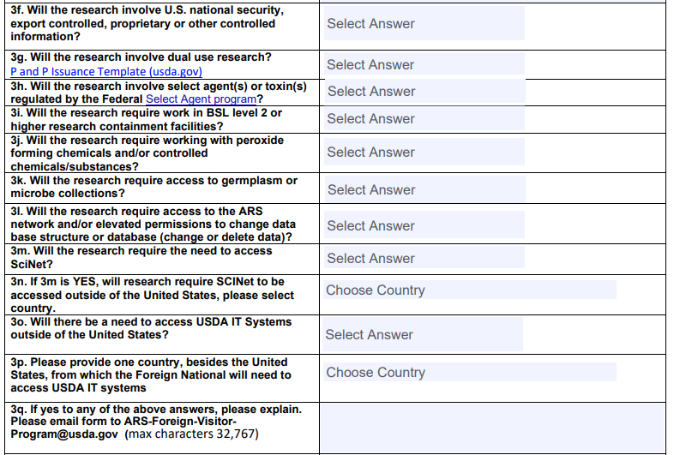
Project Information– Section 3 Continued
If any of the questions are yes, 3q. Must be filled out.

Slide 21
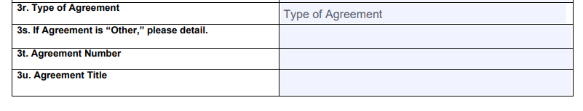
Project Information– Section 3 Continued
3r. – Select the Type of Agreement from the List
3s. If OTHER is selected (may be ORISE) – Type Information in this box (e.g. ORISE Agreement may be “Outgoing Interagency Agreement”)
3t. Agreement Number – List the Agreement Number in Box, must match what is in ARIS.
3u. Agreement Title – List the title, must match what is in ARIS.

Slide 22
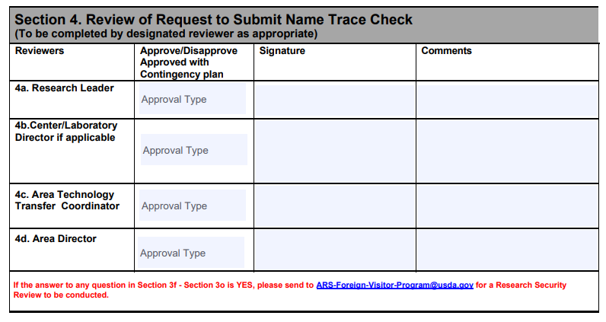
Project Information– Section 4
4a., 4c.- 4d. Mandatory Signatures
If unit has a Center or Laboratory Director – must sign as well
After Obtaining 4a (and 4b if applicable), please send document to Area Office to obtain other signatures – this will go to Administrative Support Assistant at Area Office to track signatures of TTC and Area Director/Associate Area Director

Slide 23
Returning of Pre-Name Trace Paperwork
After Midwest Area Office of the Director returns the following:
  Biographical Sketch
  Project Information
Paperwork must be submitted with name trace ticket, DHS will be moving forward that paperwork must be submitted or there is potential DHS will not pick up name trace ticket. This is important not to delay paperwork.
NOTE – Just because the Area Office signs off on the pre-trace name paperwork does not guarantee the FN/FV will be allowed to work in unit. Area Memo and 215 POST name trace still needs to be signed off on.

Slide 24
Name Trace
Ticket
To HRL
Deborah Melendez

Slide 25
Guidance / Policy
AXON FV Foreign Visitor Program
https://axon.ars.usda.gov/Inside%20ARS/AO-Hub/Pages/ARS-Foreign-Visitor-Program.aspx
AXON FV Fastrack Page
https://axon.ars.usda.gov/Inside%20ARS/AO-Hub/Pages/FVFastrack.aspx
Current Fastrack Guide
https://axon.ars.usda.gov/Inside%20ARS/AO-Hub/Documents/FVFastrack%20User%20Guide%203.5.pdf

Slide 26
What Requires a Name Trace?
ANY FOREIGN NATIONAL TO USDA FACILITIES THAT INCLUDE THE FOLLOWING:
May be visiting ARS or one of the ARS’s client agencies.
May be visitors, contractors, students, volunteers, collaborators or federal employees.
May be short-term or long-term foreign visitors.
May have escorted or unescorted access to facilities.
May or may not have system access.
May or may not be sponsored by ARS or client agencies.
May or may not require assistance acquiring a visa.
Includes foreign visitors, previously cleared, who have left the country for 30 or more days.
Includes foreign visitors staying more than five (5) consecutive days or more than five (5) non-consecutive days in a 30-dayperiod
Includes foreign visitors staying five (5) days or less and hands on work/research will be conducted.

Slide 27
What Does NOT Require a Name Trace?
The following types of non-US Citizens that are NOT included in this process:
If the stay is five (5) days or less consecutive days or five or less non-consecutive days within a 30-day period AND the foreign visitor will not conduct any hands-on work/research. Foreign visitors who visit ARS facilities/spaces (even when co-located on a university campus MUST fully complete the visitor log upon arrival. The visitor log shall be retained by the Location (and, as required, provided to the Center or Area) for audit purposes. The foreign visitor log does not need to be reported to Administrative and Financial Management (AFM).
All legal permanent residents, Green Card holders. Green Card MUST be valid and not expired.

Slide 28
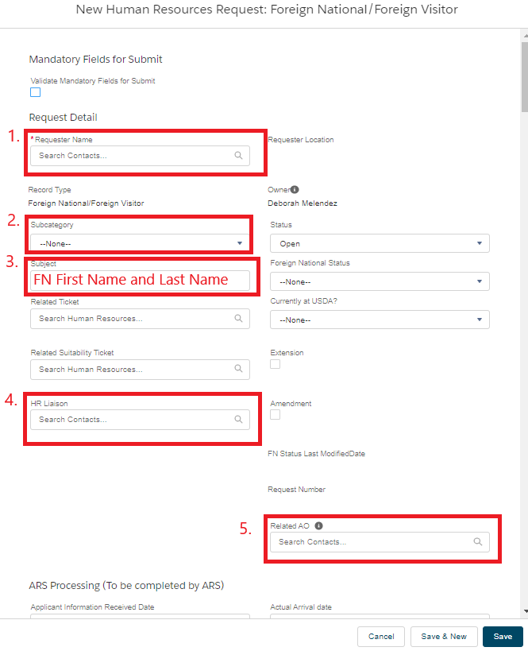
PSA requests the information from the ARS SY (Scientist) in order to create a new portal ticket
https://usda.force.com/AFMCSP/s/
What needs to be filled out
Requestor Name - Name of requestor
Subcategory – Choose which is applicable
Subject – Foreign National first name and last name
HRL – Deborah Melendez needs to be in there, so we get notifications.
Related AO – Needs to be there so the AO gets notifications
If there are any related tickets, put the ticket # in related ticket/suitability sections
Foreign National Status
Currently at USDA

Slide 29
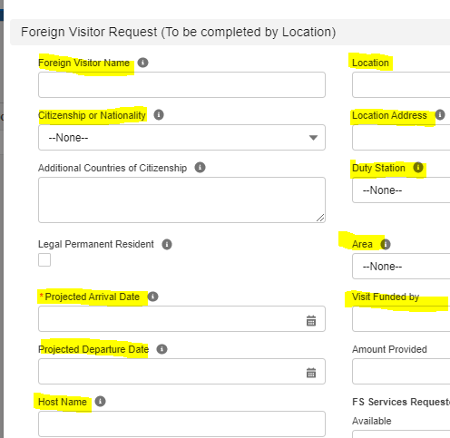
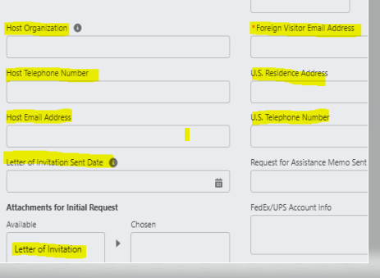
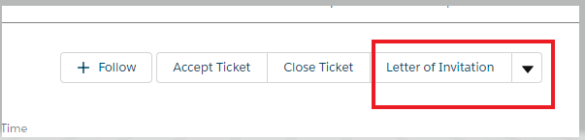
Confirm with ARS host (SY) Who is sponsoring the foreign national’s visa. The FV should already have a student Visa (F1 Visa) that allowed them to come to the US or a professor/research scholar Visa (J1 Visa)
Fill out sections below:
• FV Full Name
• Location
• Citizenship or Nationality
• Location Address
• Duty Station
• Area
• Projected arrival date
• Projected departure date
• Host Name-ARS SY (Scientist)
• Host Organization-USDA-ARS
• FV Email Address
• Host phone
• US Residence Address of FV
• Host email-ARS SY
• Host phone-ARS SY
Once all is filled out, save ticket.
(If you missed any fields that is required, the ticket won’t save).
The button to create the LOI is at the top right of ticket. You can now upload documents and create the LOI.

Slide 30
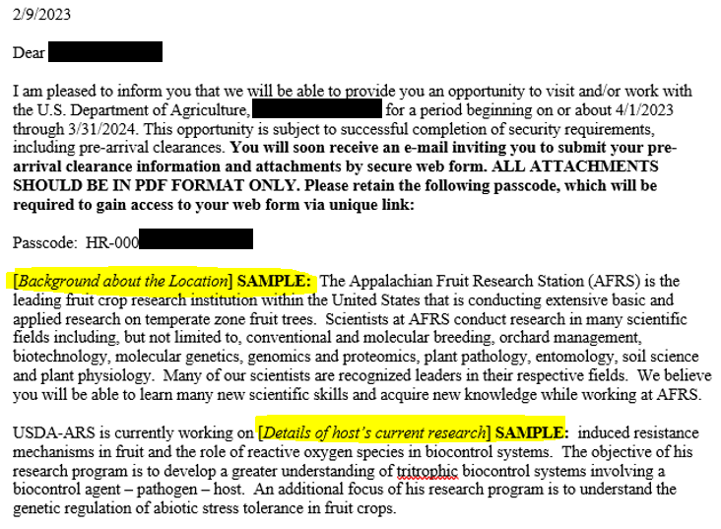

To Generate the LOI (letter of Invitation) – ticket must be in saved mode.
The PSA coordinates with the ARS host regarding the specific language to be used in the LOI.
Once you click the Letter of Invitation button, the LOI will be in the attachments tab. Click on the LOI; it opens in a Word document.
  Edit LOI, save it on the desktop
  Email it via Outlook to the FV.
  Upload new LOI on Portal ticket
A unique password is on the LOI and is the HR portal ticket number.
Once emailed, go back to ticket and upload the updated LOI.
Ensure there is the date the LOI was sent in the block labeled ‘Letter of Invitation Sent Date’.

Slide 31
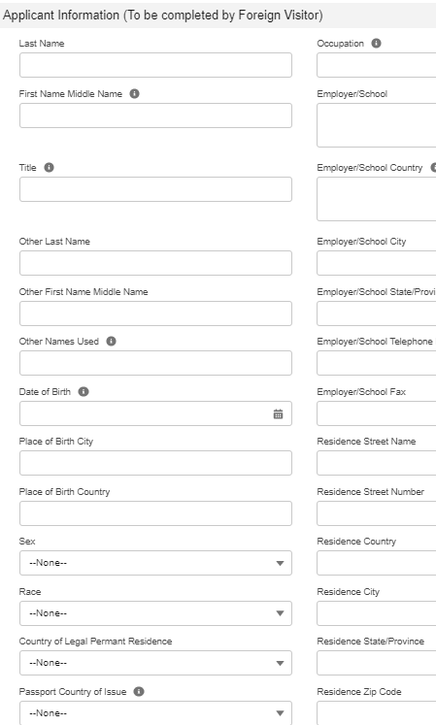

The Applicant Information (to be completed by FV or Requestor) in this section. ALL fields need to be filled out.
Not mandatory to send the LOI to the FV. The Requestor can fill out this section, but Requestor must fill out all fields and upload all the documents. If FV fills this section out, please ensure they filled in every section.
If any issues arise with creating the ticket, contact HRL.
Documents required:
• LOI
• Passport-copy of front with picture, make sure not expired
• Biographical sketch
• Project Information
• Resume
• Transcripts (for all foreign students and post-docs)
• OF-306
• ARS-215
• Area Memo
• Green card (for existing name traces that need to be closed, may not come up until time for renewal)
If J-1 Visa additional requirements:
• Proof of funding
• I-94
• J-1 Visa
• DS-2019
• proof of health insurance
NEW BOX:

Slide 32
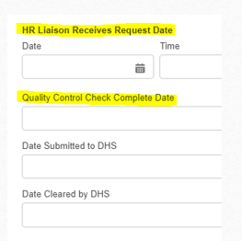
PSA - Reviews the ticket to make sure the FV has completed and uploaded necessary documents.
Ticket can be submitted.
Ensure the ticket goes to the HR Liaison queue, If it doesn’t contact the HRL
HRL will perform quality control of the ticket
HRL will mark the Quality Control Check Date box. This will notify the Foreign National Program Manager to submit the Name Trace clearance to DHS.
The Name Trace Clearance should be started 90-120 days ahead of projected arrival date per the Fastrack guide.

Slide 33




When the projected arrival date gets pushed back
If the projected arrival date passes and the FN has not arrived update this to a future date
When the FN arrives
Update actual arrival date, update currently at USDA field, and ensure nonfed suitability ticket is started and linked on

Slide 34


Extending a Foreign National
•If FN left ARS/USA 30 days or more – Must create a new Foreign National ticket and request a new name trace clearance
•If FN did not leave: Follow internal process to get approval for extension and funding
Requestor (If requestor needs to be updated, reach out to HRL to update)
• Checks the Extension Box
• Updates Projected Departure Date
• Updates new information in the Foreign Applicant Section
• Check attachments (visa, passport, etc. for current status)
• If passport or visa is expired, the requestor reaches out to the FN to
have the FN provide updated documents.
• Submit Biographical Sketch and Project information 90-120 days before current paperwork expires. Check with area on when to submit ARS-215 / Extension Memo

Slide 35
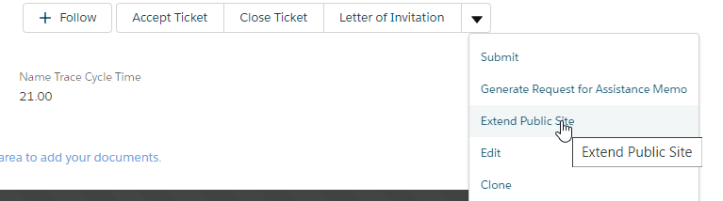
Extending a Foreign National cont.
•Extend public site to give the FN new access if needed

Slide 36
Common Errors
LOI is a sample, needs to be updated
Projected arrival date needs to be updated once that date is in the past, or the arrival date needs to be entered.
Projected departure date needs to be the same as the ARS-215.
Un-password protect the document before uploading documents. Password protection is required to protect PII when emailing.
Agreement date/D project needs to match ARS-215
Area Office is NOT notified when your name trace is complete, please send email with 215 and Memo with notification name trace/extension name trace is completed.
Opening the ticket an incorrect way.
Chatterfeed HRL on ticket if they were waiting on something. (The HRL does not necessarily get notified of a change.
FN/FV can NOT be in ARS Facilities until 215 & Memo are signed and returned to the unit. This is non-negotiable.

Slide 37
Area Office Post Name Trace Paperwork
To Area Office
Christina Brown

Slide 38
Post Name Trace Paperwork - Memo
Use the same name on passport.
Do not use professional name if Foreign National goes by something different.
The full name and location of Unit where the Foreign National will be conducting research.
Country of Origin and Citizenship.
Dates to be in Unit.
Only one year at a time due to Name Trace needing to be conducted yearly and potential funding issues. (Look at DProject, Agreement and Name Trace Expiration) – use what expires FIRST
The Project Number, Name and Objectives the Foreign National will be working on
Agreement Number
How ARS will benefit with Foreign National Conducting Research
Signatures Needed
Host Scientist
Research Leader
Center/Lab Director, if applicable or Administrative Officer
Associate Area Director
Funding
How is the FN/FV going to fund stay?

Slide 39
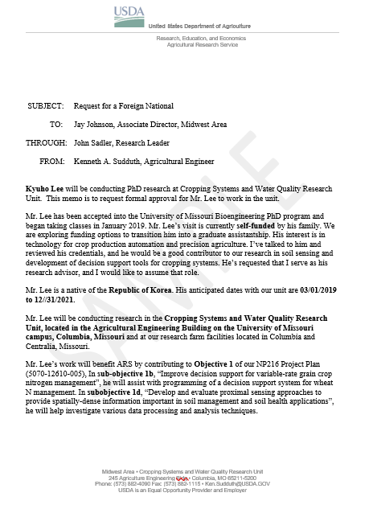

Slide 40

Post Name Trace Paperwork – ARS 215
Agreement Number
If the Foreign National is working under an agreement, enter the ARS agreement number associated with the project and the type of agreement (e.g., CA, RSA, RCA, etc.).
You might have more than one agreement for the year, check your agreement dates. If this is the case, you will have more than one 215.
If there is no agreement (or will be no agreements) between ARS and the home institution, or between ARS and the Foreign National’s employer (e.g. University in the United States), at the time the Foreign National will be working in the ARS Facility, enter “NONE” in this box.

Slide 41
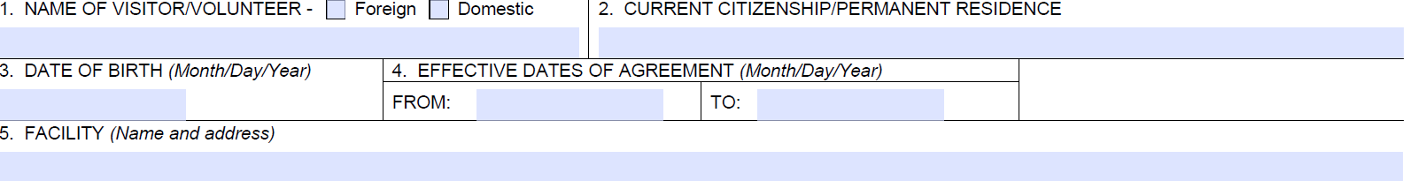
Post Name Trace Paperwork – ARS 215
215 Blocks #1 - 5
Block 1:
  Enter full name that is shown on passport.
  Check if Foreign or Domestic Block.
Block 2:
  Enter the Country of Citizenship/Permanent Residence.
    Enter just the Country Name, not full address.
Block 3:
  Enter Date of Birth shown on passport.
Block 4:
  Enter dates of agreement that will correspond with the dates of the Foreign National be with ARS.
  Check your agreement dates.
Block 5:
  This refers to the ARS Facility (Enter the full name of the Unit and Address of the ARS Facility)

Slide 42
Post Name Trace Paperwork – ARS 215
215 Block #6
Enter the ARS Research Project Title to which the Foreign National will be conducting research
  If the project involves a Cooperative Research Agreement, include the agreement title that matches the agreement number at the top of the page and identity the type of agreement.
    If the complete title does not fit, enter as much as possible
  If the agreement is a Research Support Agreement (RSA) and not a Cooperative Research Agreement, indicate the RSA number at the top of the page and the funding cooperative research project title and agreement number in block 6, if the project is externally funded.
  If the RSA is associated with the D project funding only, enter the D Project Number and title in block 6.
  If there is no cooperative research agreement, provide the number and title of the in-house D Project in block 6.

Slide 43
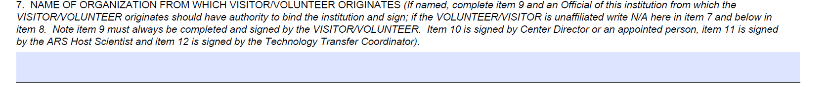
Post Name Trace Paperwork – ARS 215
215 Block #7
Enter the Name and Address of the Foreign National’s Employer/Organization (at the time they will be working in the ARS Facility).
  If the Foreign National is NOT employed by another party and has no other organizational affiliations, type N/A here.
  If the Foreign National is paid through ORISE, they will not be an employee of any institution, type N/A – ORISE.

Slide 44
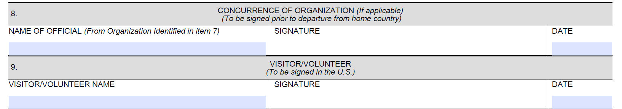
Post Name Trace Paperwork – ARS 215
215 Block #8 & 9
Block 8:
  Enter the name of the official listed in block 7.
  If N/A is entered in block 7, enter N/A in block 8.
Block 9:
  The Foreign National must sign in this box.
Both boxes must be signed (or N/A for box 8) before 215 is sent to the Area. The 215 will not be approved unless signatures are obtained.

Slide 45
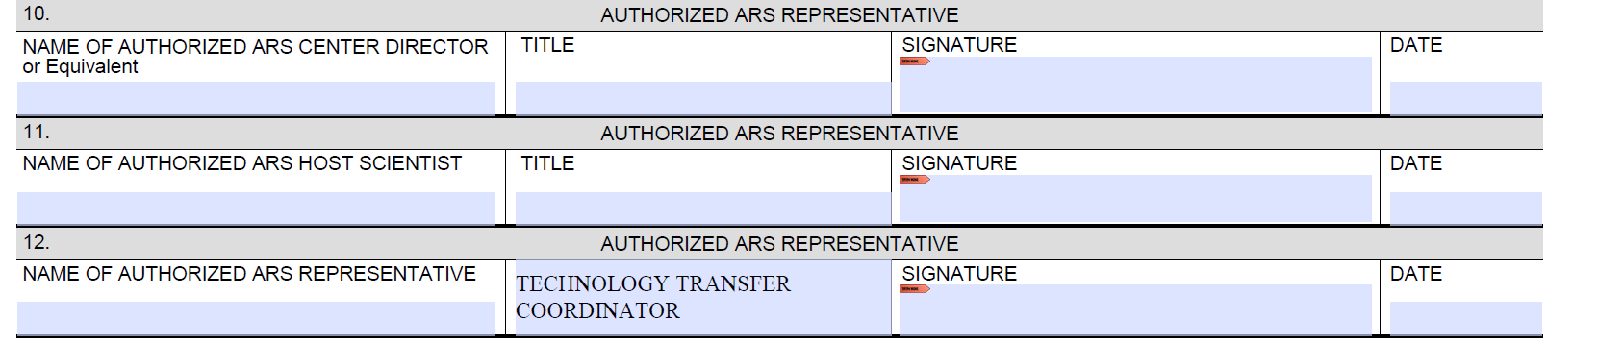
Post Name Trace Paperwork – ARS 215
215 Block #10 - 12
Block 10:
  Enter Name of Center Director.
  If no Center Director, the Midwest Associate Area Director will sign here. Enter the following:
    Name : Jay V. Johnson
    Title: Associate Area Director
  Research Leaders will not sign the 215 (unless they are the Host Scientist – will be in block 11)
Block 11:
  The ARS Host Scientist will sign and enter title
Block 12:
  Technology Transfer Coordinator will sign here. Enter the Following Information
  Enter the following:
    Name : Ken Doll
    Title: Technology Transfer Coordinator

Slide 46
Post Name Trace Paperwork – ARS 215
Additional Information
If there is a cooperative research agreement in place, Dr. Doll will check to make sure the agreement will not conflict with the ARS 215 and will notify if 215 needs to be amended.
The forms can be either physically or electronically signed, however, if signing electronically, following a physical signature, it is helpful when signature blocks are added onto the document. Please do not take a picture of the document, please scan or the document becomes distorted. If a scanner is not readily available government issued phones do have Microsoft Lens App, that should be used as a last resort.
Requests to extend time for Foreign National:
  New Name Trace MOST likely will be the necessity
    Same Paperwork Required:
      Pre-Extension: Project Information
      Pre-Extension: Biographical Sketch
      Post Name Trace Extension: ARS 215
      Post Name Trace Extension: Memo to Area
All 215s and Memos must be upload back to the Name Trace Ticket for housing.
Please unprotect before uploading to Name Trace Ticket Portal.

Slide 47
Nonfed Suitability Ticket
To HRL
Deborah Melendez

Slide 48
What is the function of PSS?
Responsible for collecting and reviewing all background and security clearance forms for accuracy
Responsible for making determinations regarding an employee’s suitability to occupy a sensitive position and/or eligibility for access to classified national security information.
AXON Page - Personnel Security and Suitability Program https://axon.ars.usda.gov/HRD/Pages/Personnel-Security-and-Suitability-Program.aspx

Slide 49
Who is required to have a background investigation?
ALL appointments in the Federal Service (to include contractors, volunteers, and foreign nationals) require some level of background investigation, screening, and/or security clearance.

Slide 50
Types of Non-Federal employees and documents required by PSS
Contractors:
PII Form
OF-306
Resume/CV
Scanned copy of shipping label for fingerprints
Volunteers:
PII Form
OF-306
Volunteer Service Agreement (ARS-215)
Resume/CV
Scanned copy of shipping label
Foreign Nationals:
PII Form
OF-306
Resume/CV
Scanned copy of shipping label for fingerprints

Slide 51
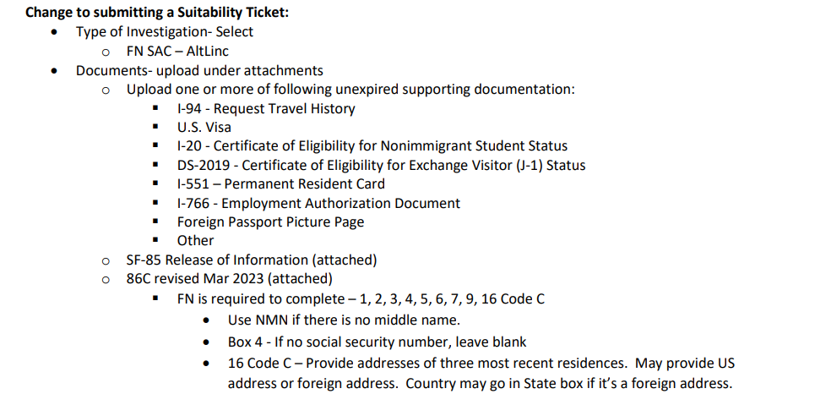
New Changes
Foreign Nationals Less then 3 years in United States
Refer to email sent out 05/03/2023 by DAAFM-AFM.Communications DAAF-AFM.Communications@usda.gov

Slide 52




Non-Federal Employee Suitability ticket information
On Name trace ticket link to suitability

Slide 53
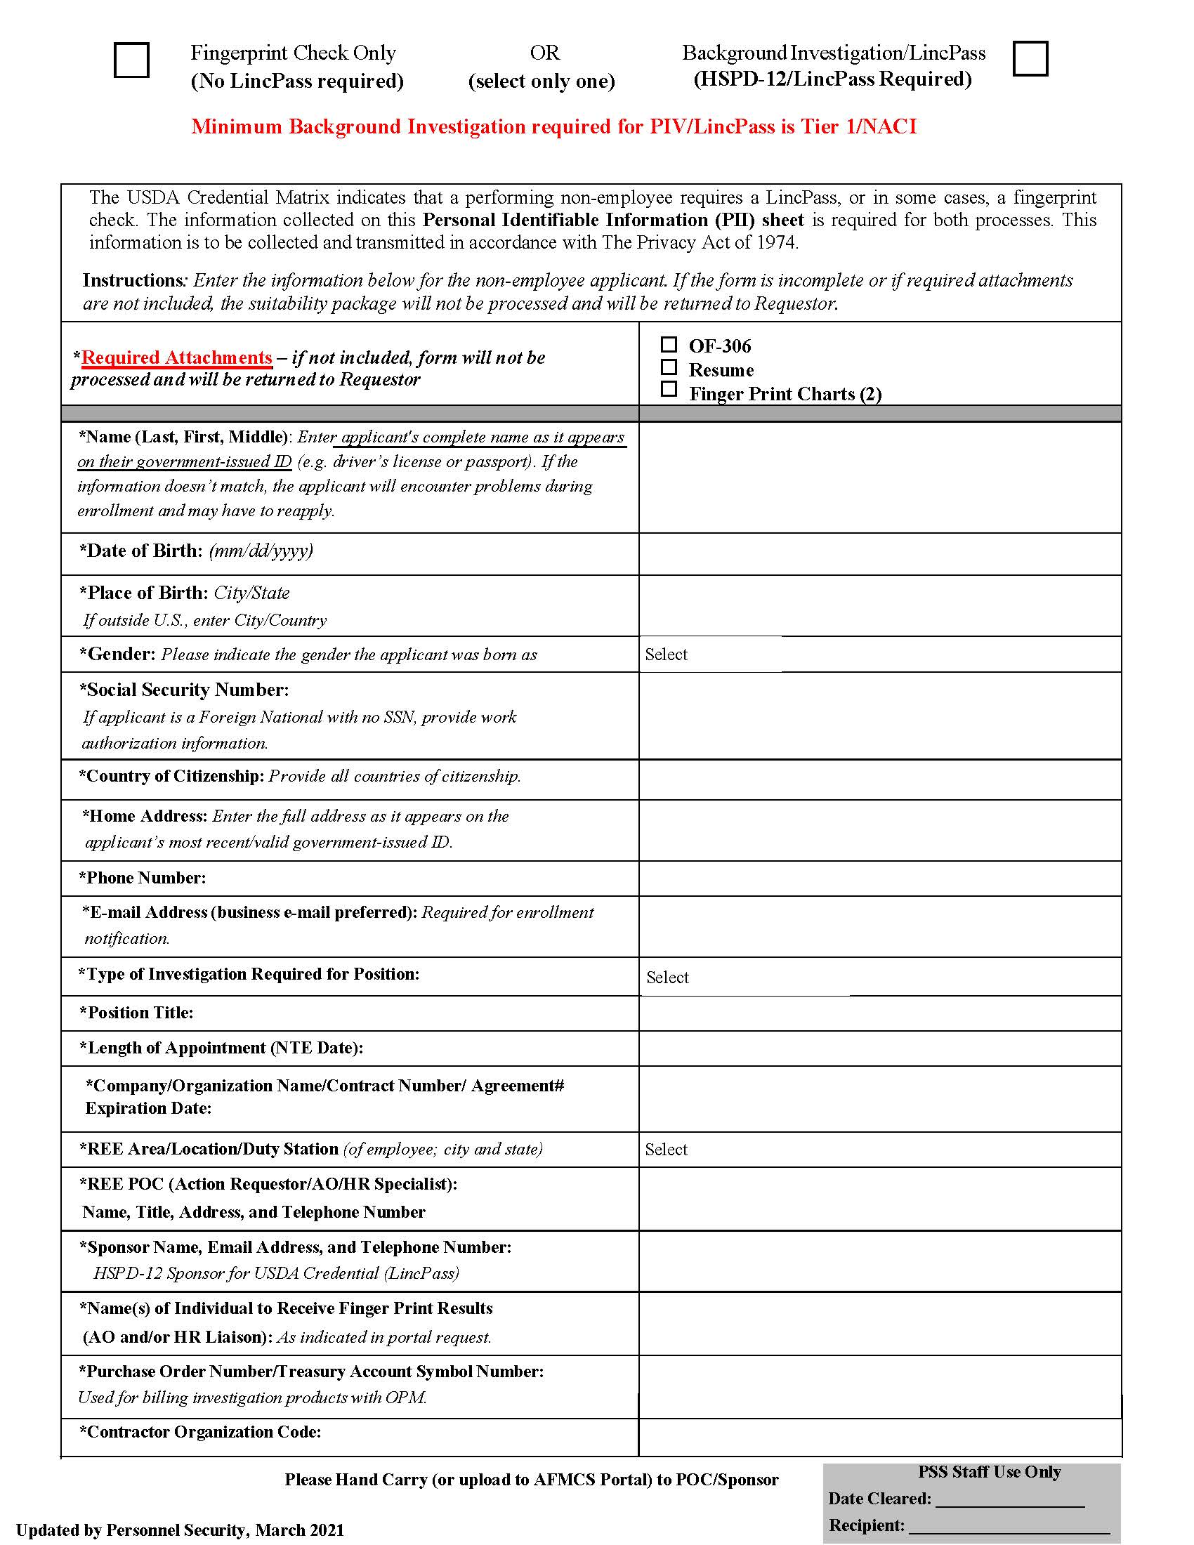
PII Form – Must be entirely filled out
Name: Enter applicant’s COMPLETE name – Last, First, Middle
Date of Birth: (mm/dd/yyyy)
Place of Birth: City/State (If outside U.S., enter City/Country)
Gender: Indicate gender at birth
SSN: If no SSN, leave blank
Country of Citizenship: Provide ALL countries of citizenship
Home Address:
Phone Number:
E-Mail Address: Business e-mail address preferred
Type of Investigation:
Position Title:
Length of Appointment: (NTE Date)
Company/Organization Name/Contract Number/Expiration Date:
REE Area/Location/Duty Station: City/State
REE POC: Name, Title, Address and Telephone Number
Sponsor Name, Address and Telephone Number:
  Deborah Melendez, 1815 N. University St., Peoria, IL 61604
Name(s) of Individuals to receive Finger Print Results: (AO and/or HRL)
PO Number/Treasury Account Number: Used for billing investigation products with OPM
Contract Organization code: EXAMPLE 50-5090-15-10
https://axon.ars.usda.gov/AFM/Documents/2021-4-5%20Updated%20Personal%20Identifiable%20Information%20(PII)%20Form.pdf#search=pii%20form
Notes:
Important top portion, ensure you click one. Next to REE location write site

Slide 54
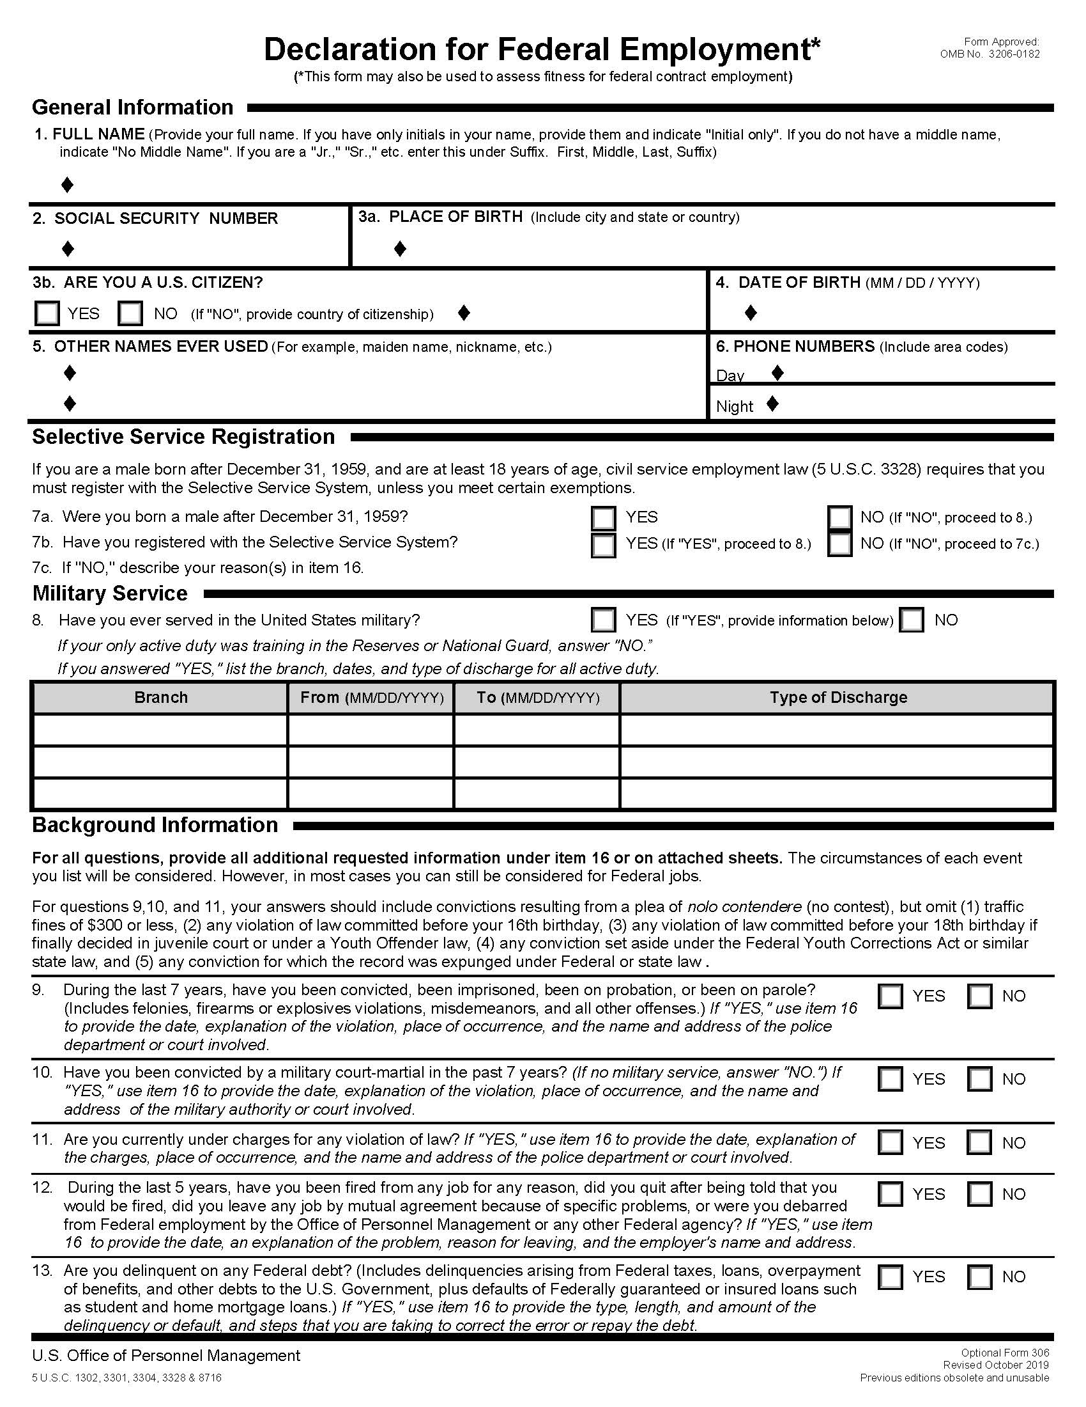
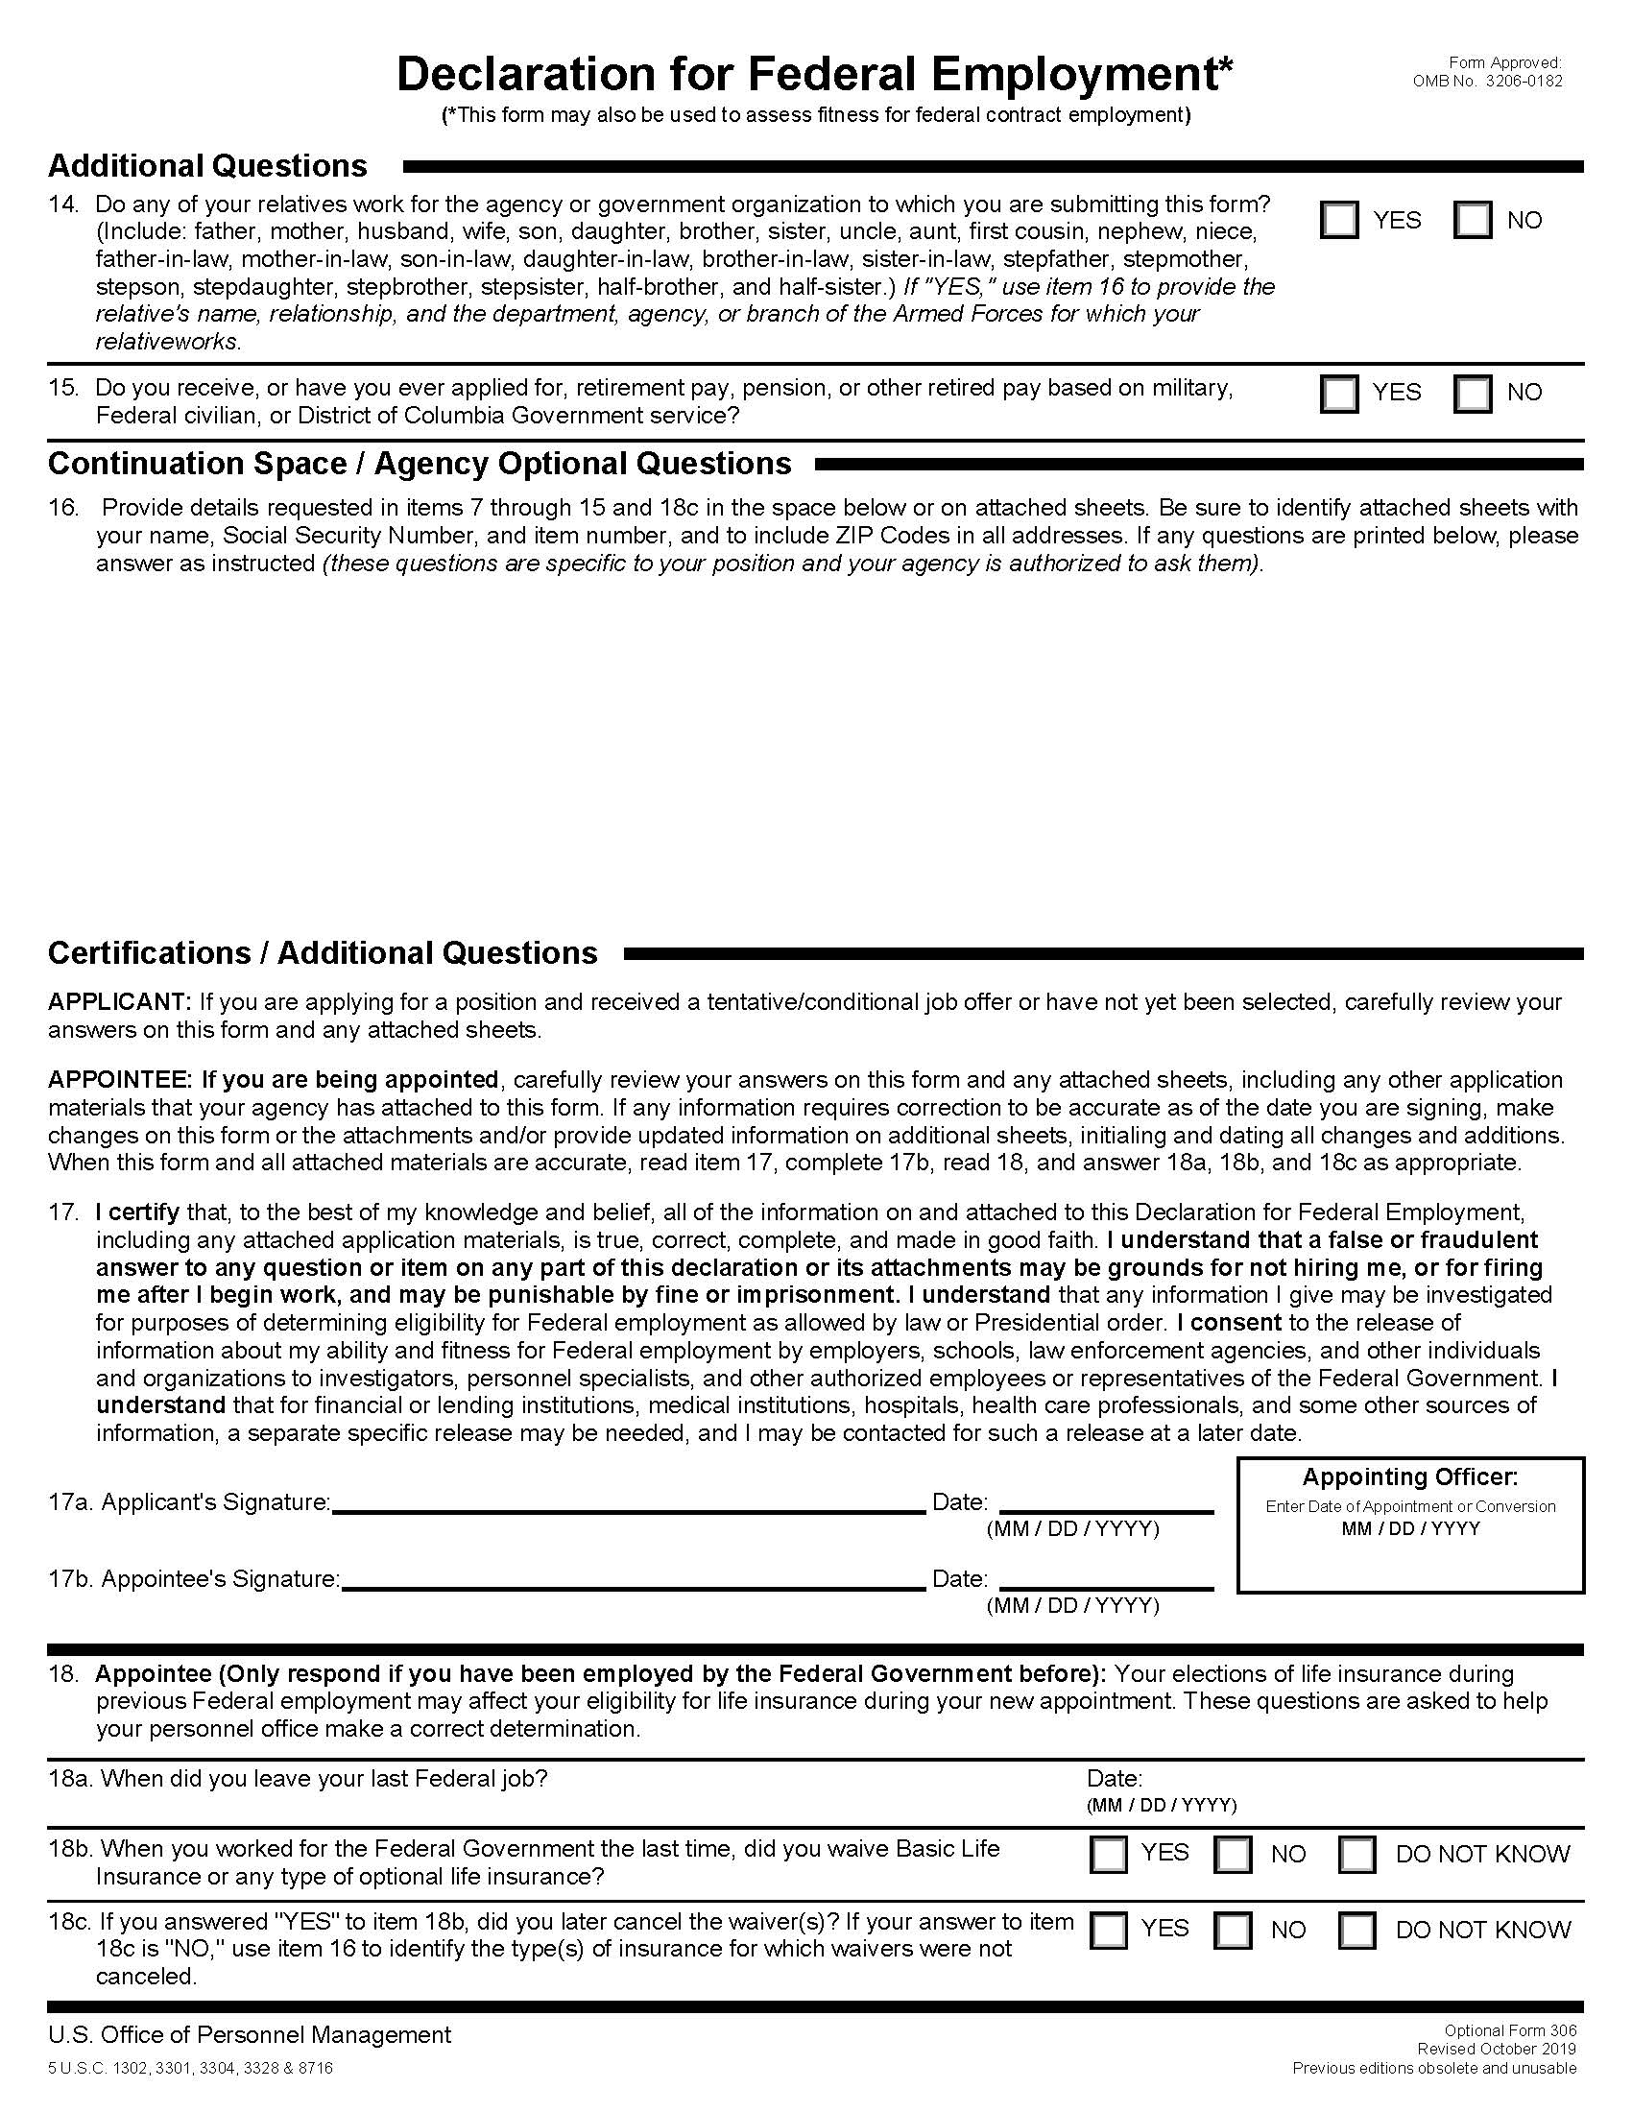
OF-306 Must be entirely filled out
https://www.opm.gov/forms/pdf_fill/of0306.pdf
Must be completely filled out by the applicant.
Can be filled out by hand (black or blue ink) or by computer. It CANNOT be both.
Question 1 – Must include ENTIRE name: First, Middle, Last, Suffix (if applicable). IF “No Middle Name” MUST indicate “NMN”.
Question 3b – If ‘no’ is check marked, then a country needs to be listed next to the diamond.
Question 7a – If a male answers this question “yes” and does not answer Question 7b “yes”, an explanation must be given in block 16.
Question 8 - Needs to be checked either ‘yes’ or ‘no’.
Questions 9-15 – If answer is “yes”, an explanation must be given in block 16.
Question 16 – please identify the question it was referring to.
Applicant MUST sign and date on line 17a.
Date MUST be MM/DD/YYYY format.

Slide 55
How to create a ticket for suitability – Non-Federal
AO/PSA initiates a Suitability New Non-Federal ticket in the portal when an agreement is signed or a contractor is identified.
Select “Human Resources Request”
Select “Suitability New Non-Federal”
Complete the “Request Detail” section information
  The Location Staff’s name always goes into the “Requester Name” field.
  When appropriate, enter the “Related Ticket” number for the FV ticket.
  “Status” data is not needed.
  Fill in the “Related AO” using the magnifying glass search capability, even if the AO is the Requestor.
  **NOTE** PSS uses this field when e-mailing notifications.

Slide 56
How to create a ticket for suitability – Non-Federal (cont)
Fill out the “Selectee Detail” section information.
  Indicate Employee type: contractor, volunteer, other.
  If a LincPass is not needed select “no” in the LincPass Required” field.
Select “Save”
Select “Attach File” in the “Attachments” section and upload the required documents.
In the “Required Attachments” section, check the boxes for all documents uploaded to the ticket.
Select “Submit”. The ticket moves to the HR Liaison’s queue to be Quality Checked.

Slide 57
How to create a ticket for suitability – Non-Federal (cont)
AO or designee ships fingerprints to PSS. Upload a scanned copy of the shipping label to the ticket and check the “Copy of Shipping Label for Fingerprints” box in the “Activity History”. If sent electronically, check this box instead.
  Fingerprints should include a printed cover sheet of the related Suitability ticket for ease of matching in PSS.

Slide 58
How the HR Liaison works a Suitability Non-Federal ticket
Once suitability ticket is received and quality checked, the HRL enters contractor/volunteer/foreign visitor into EmpowHR (Person Model) and time stamps when the non-federal is applied into EmpowHR.
  **NOTE** HRL will obtain a Pseudo SSN for selectee’s who do not have a U.S. SSN.
HRL sponsors new non-federal and time stamps date into the ticket.
HRL reassigns the ticket to the PSS queue.

Slide 59
How PSS Officer works a suitability Non-Federal ticket
PSS Officer submits fingerprints and enters a date stamp into the portal ticket.
Once the PSS Officer determines the individual is okay to onboard, s/he records the clearance date in “Date Cleared by PSS”. The portal automatically generates notification to the related AO and HRL.
When fingerprint results are returned, PSS Officer will date stamp the portal ticket and record fingerprint adjudication results.
PSS Officer inputs results into USAccess.
PSS Officer submits investigative request to OPM to process background investigation and records “Date Investigation Request Forwarded to OPM” in the portal.
PSS Officer records results of background investigation
PSS Officer closes ticket once background investigation is complete.

Slide 60
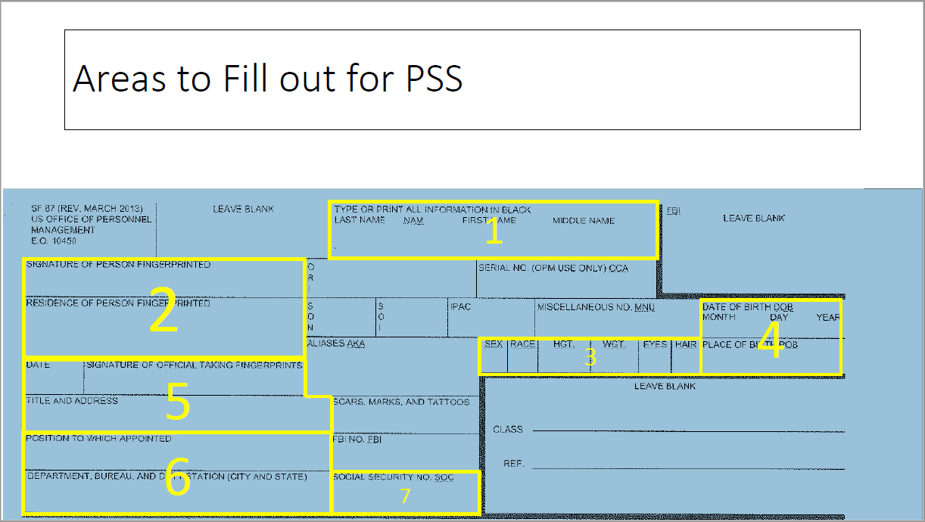
Fingerprint cards
December 2017 version of the SF 87 Fingerprint Chart
Send two (2) fingerprint cards to applicant. *Highlighted*
NBIB website for locations where prints can be done:
https://www.nbinformation.com/locations/
Send Fingerprint cards to:
5601 Sunnyside Ave, Rm 3-1168, Beltsville, MD 20705

Slide 61
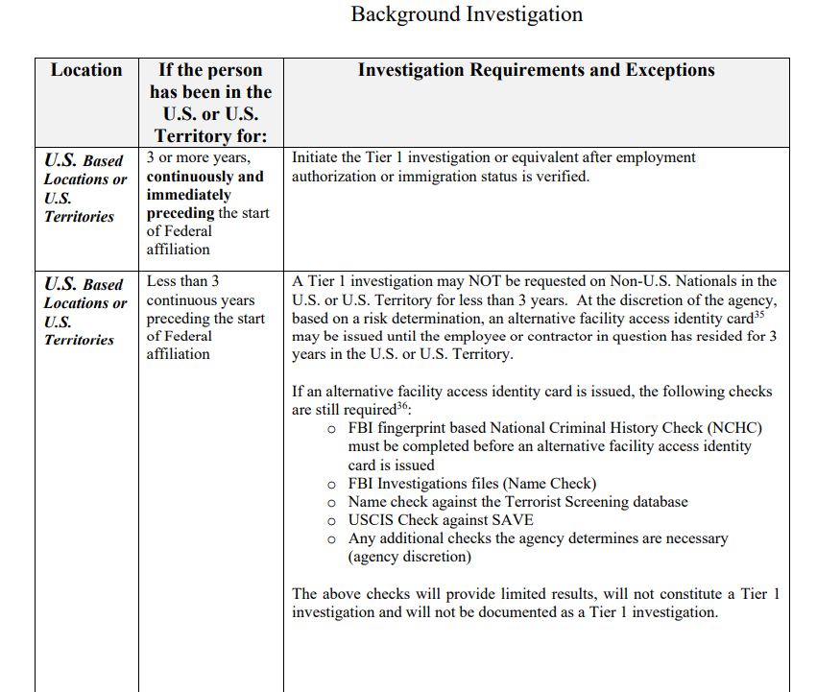
Lincpass Residency Requirement
Foreign Nationals must have a minimum of a 3-year residency to obtain a PIV card.
https://www.opm.gov/suitability/suitability-executive-agent/policy/cred-standards.pdf
Alt-Linc will be used if a Foreign National does not meet the 3 Year Requirement. This Alt-Linc will need to be reissued every 6 months until the 3 Year Requirement is met.

Slide 62

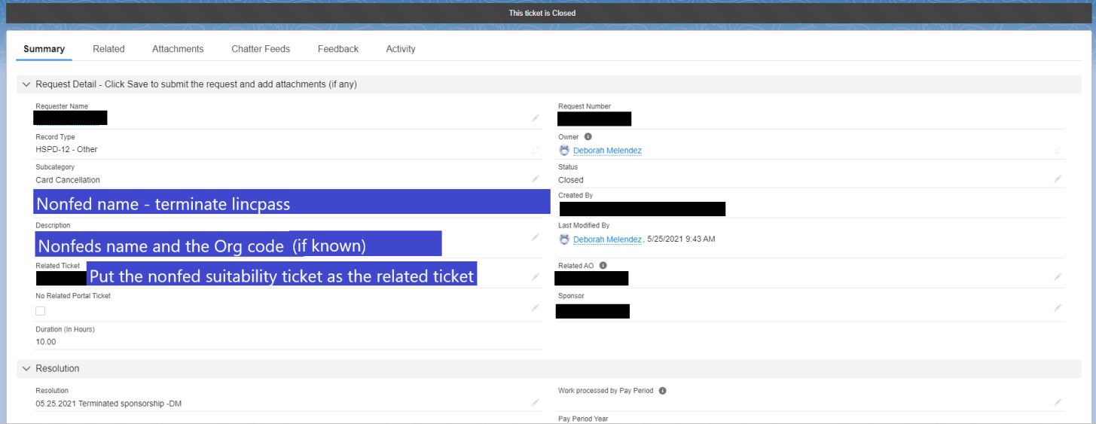
Separating Contractors
Anyone who has had a suitability ticket on them will need to be terminated in the system when they leave. Whether they have a lincpass or now. The best way for me to know is if you submit a ticket.
Example:

Slide 63
External Links
To HRL
Deborah Melendez

Slide 64
External Links
ARS Foreign National Visitor Program
ARS Foreign National Visitors Biographical Sketch
ARS Project Information for Foreign Visitors
Foreign National Request Memo
Electronic Forms – Axon
ARS 215 – Please delete old ARS 215 and use the most recent
OF-306
Midwest Area SOP Manual
AFM Customer Service Portal Information – Axon
ARS FV Fastrack Processing
Personnel Security & Suitability Program
PSS Email/New PII form
Foreign Nationals with Less that 3 Years Residency
USDA Personnel & Document Security Memo
Guidance for AltLinc
OF 86C Form-Special Agreements Check (SAC)
SF 85 Form – Release of Information

Slide 65

Questions

